Slide 1

Data Science:: Healthcare
Persistency of a drug
(Group Project)
May 2020

Slide 2
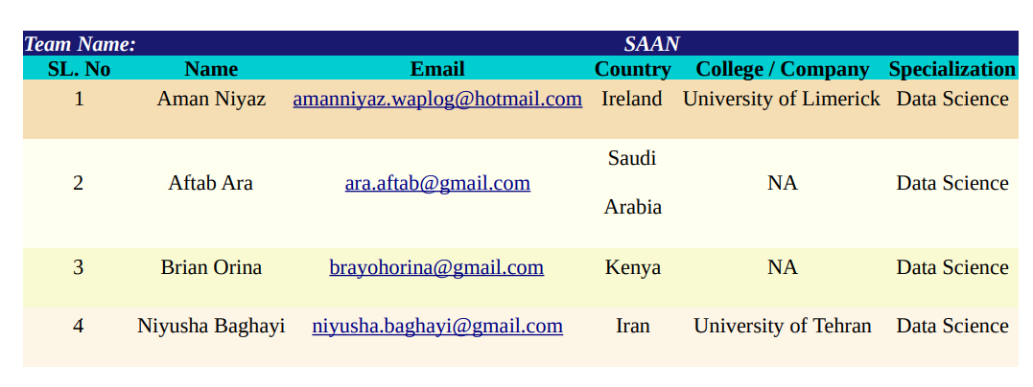
Team Members

Slide 3

Agenda
Executive Summary
Problem Statement
Approach
EDA
Model Development
Model Selection
Model Evaluation
Conclusion

Slide 4
Executive Summary
One of the challenge for all Pharmaceutical companies is to understand the persistency of drug as per the physician prescription. To solve this problem ABC pharma company approached an analytics company to automate this process of identification.
ML Problem:
With an objective to gather insights on the factors that are impacting the persistency, build a classification for the given dataset
Target Variable: Persistency_Flag

Slide 5
Problem Description
ABC is a pharmaceutical company that wants to understand the persistency of a drug as per the physician’s prescription for a patient. This company has approached an Analytics company to automate this process of identification. This Analytics company has given responsibility to Team SAAN and has asked to come up with a solution to automate the persistency of a drug for the client ABC.

Slide 6
Business Understanding
The pharma company ABC wants to understand about the persistency of a drug for a patient. There are a bunch of Non-Tuberculous Mycobacterial (NTM) infection data. ABC company wants to know whether a patient is persistent or not depending on the prescription data. Depending on the persistency count, ABC pharma company would produce medicines in that quantity so that they can run their business strategically

Slide 7
Task
Problem understanding
Data Understanding
Data Cleaning and Feature engineering
Model Development
Model Selection
Model Evaluation
Report the accuracy, precision and recall of both the class of target variable
Report ROC-AUC as well
Deploy the model
Explain the challenges and model selection

Slide 8
Approaches taken
Data was taken from github and analysed
Problem understanding
Data Understanding
Data Cleaning and Feature engineering
Model Development
Model Selection
Model Evaluation

Slide 9
Data Intake Report
Name: Healthcare – Data Science Report date: 25th April 2021
Data storage location: https://github.com/aniyaz/Healthcare-DataScience2021
Total number of files 1
Total number of features 26
Base format of the file .xlsx
Size of the data 898 KB

Slide 10
Analyzing dependency of variable (Before Transformation)
The analysis showed more non persistence of drugs than persistence
Non-Persistent : 62.35 % Persistent : 37.65 %

Slide 11
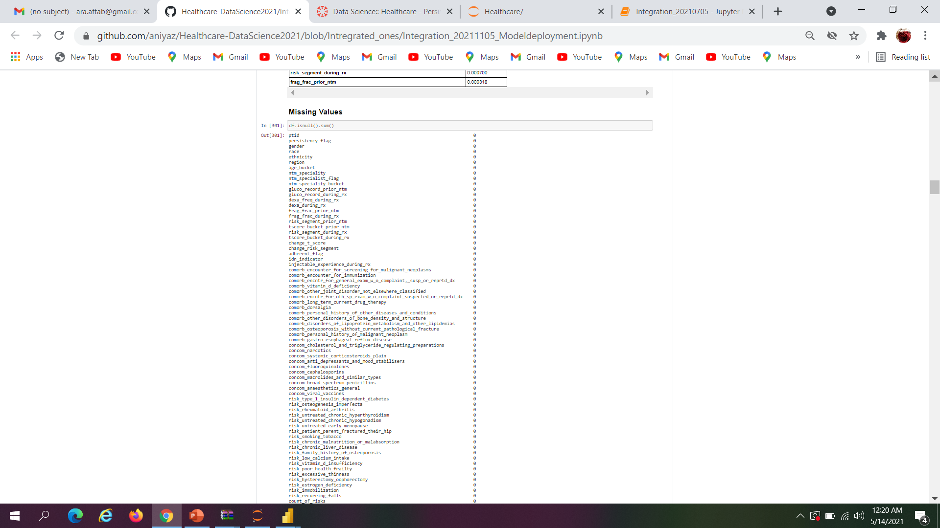
Missing Values
No missing values were found

Slide 12
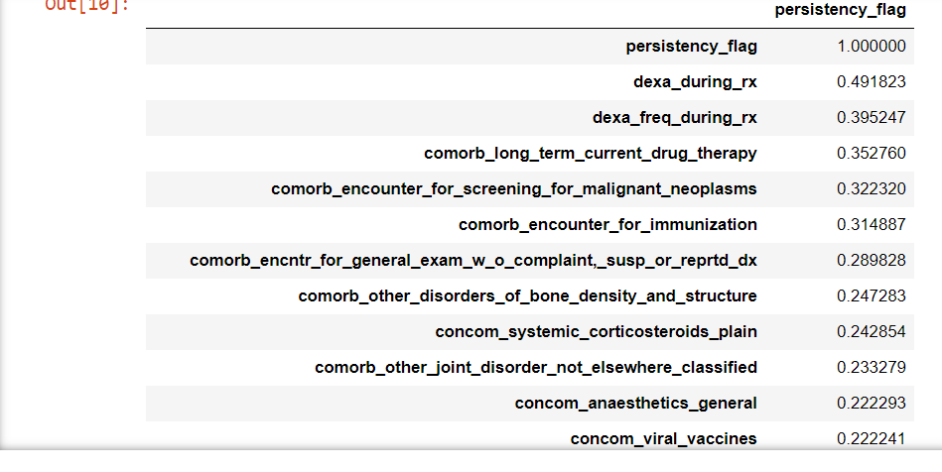
Correlation between features
We find the correlation values between the label and other features columns and it turn out that there are many columns having very less correlation value. That means it will be wise to ignore those columns to consider for model training as more number of columns that are unrelated would overfit.

Slide 13
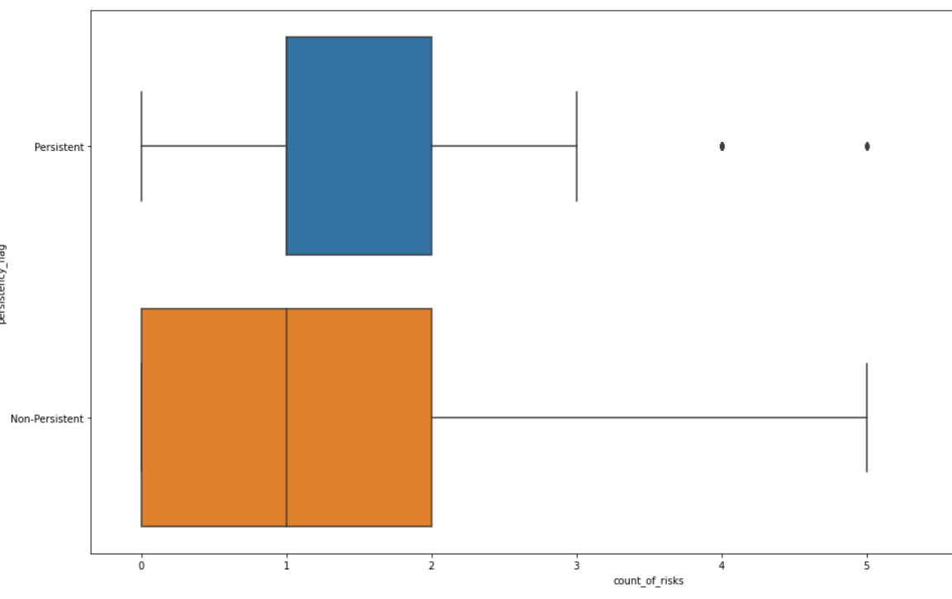
Analysis of Outliners
Visual analysis showing the outliners in one column by box plot Analysis

Slide 14
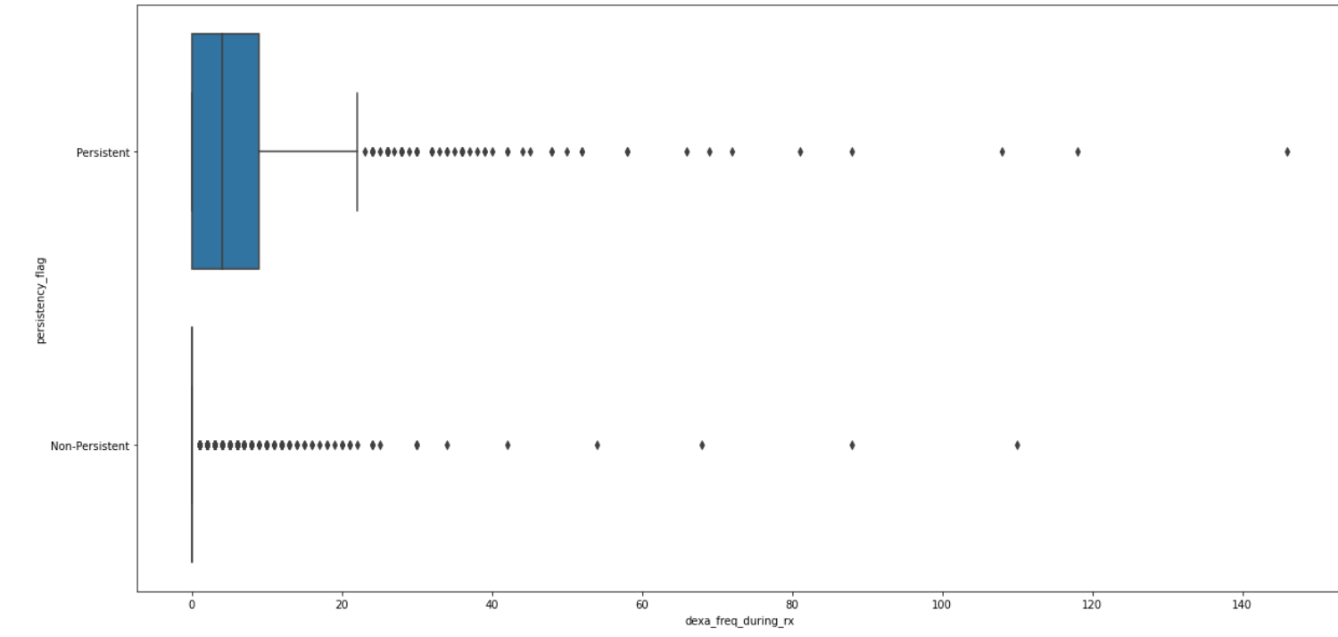
Analysis of Outliners
Box plot analysis showing the outliners

Slide 15
Analysis of Skewness and kurtosis
Data shows a moderate positive skewed data on this column and fairly platykurtic so the data has little outliers
Count of risks skweness: 0.8797905232898707
Count of risks Kurtosis: 0.9004859968892842
dexa_freq_during_rx skweness: 6.8087302112992285
dexa_freq_during_rx Kurtosis: 74.75837754795428
We can see a ery high positive skewed and also with very high kurtosis(Platykurtic) This suggests Presence of a lot of outliers.

Slide 16
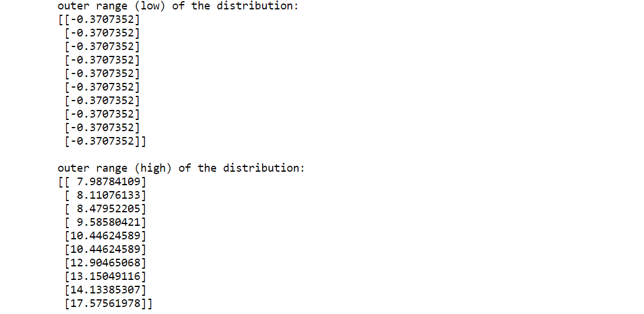
Analysis showing the standardization of dexa_freq_during_rx df
The distribution shows the low and high range of the distribution of dexa_freq_during_rx

Slide 17
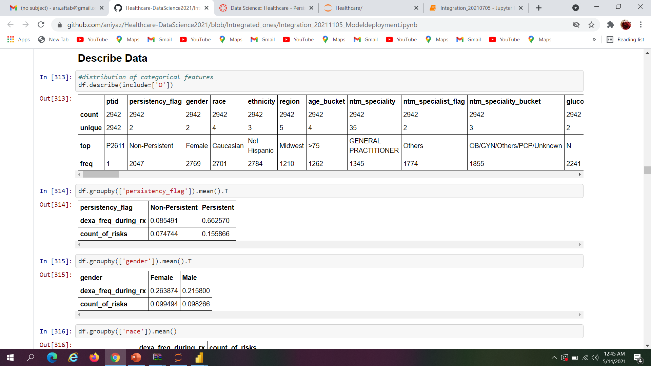
Analysis of Categorical data description
The following analysis shows the distribution of categorical data

Slide 18
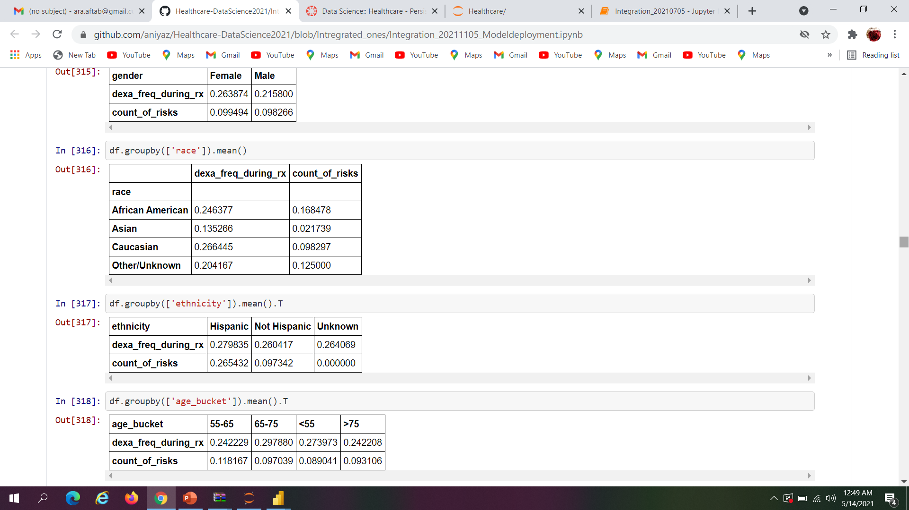
Analysis of Means group-wise
The analysis shows means group wise analysis of persistency,Gender and race during administration of dexa and risk count.

Slide 19
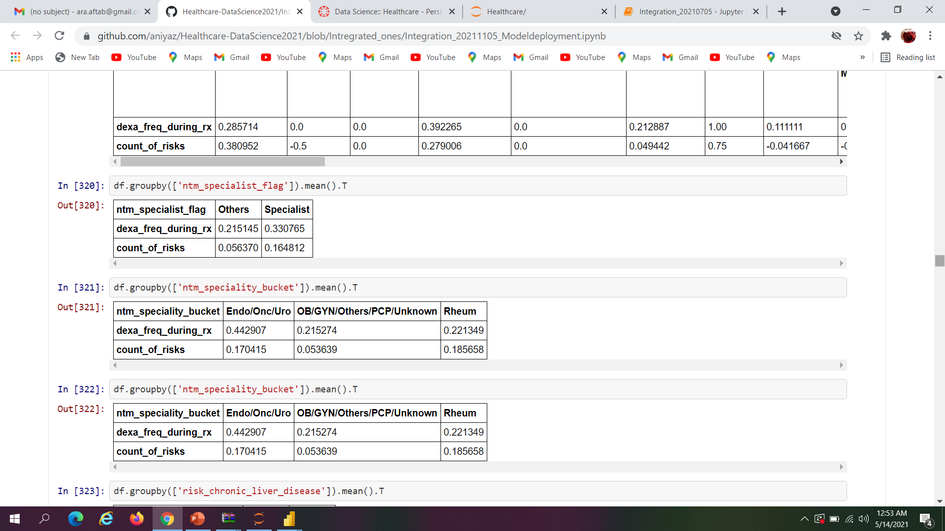
Analysis of Means group-wise
The analysis shows clearly group-wise analysis according to Ethnicity,Age and NTM specialist during administration of dexa and risk count

Slide 20
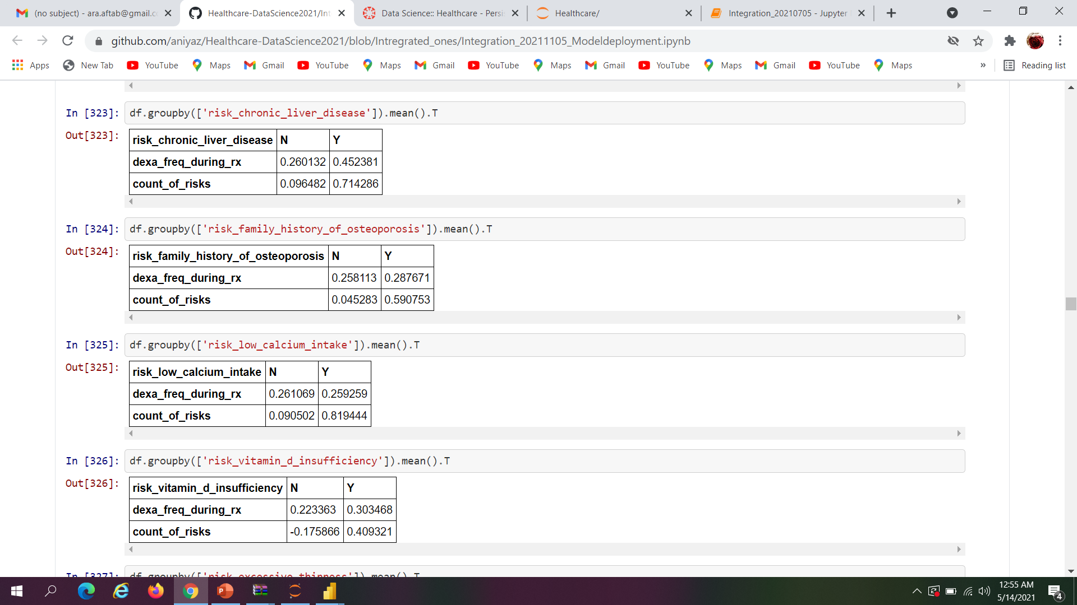
Analysis of Means group-wise cont..
Mean group wise analysis of NTM Speciality and Risk due to Chronic liver disease during administration of dexa and risk count

Slide 21
Analysis of Means group-wise cont..
Mean group wise analysis of risk due to family history od osteoporosis, risk due ti low calcium intake and Risk due to Vitamin D insufficiencyduring administration of dexa and risk count

Slide 22
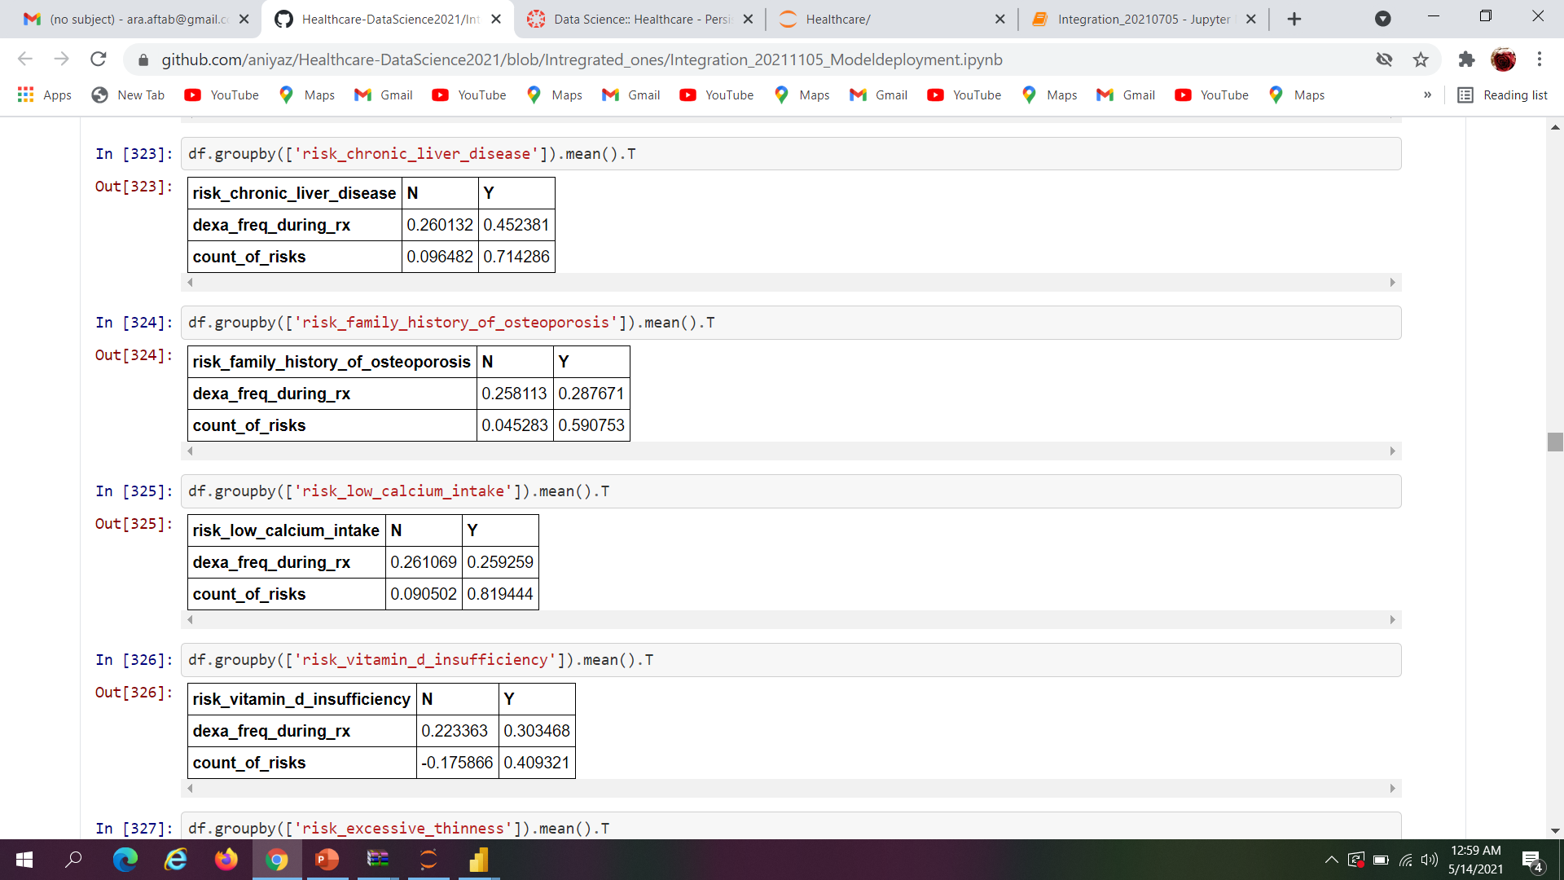
Analysis of Means group-wise
Mean group wise analysis of risk due to chronic liver disease , risk due to family history of osteoporosis and risk due to low calcium intake during administration of dexa and risk count

Slide 23
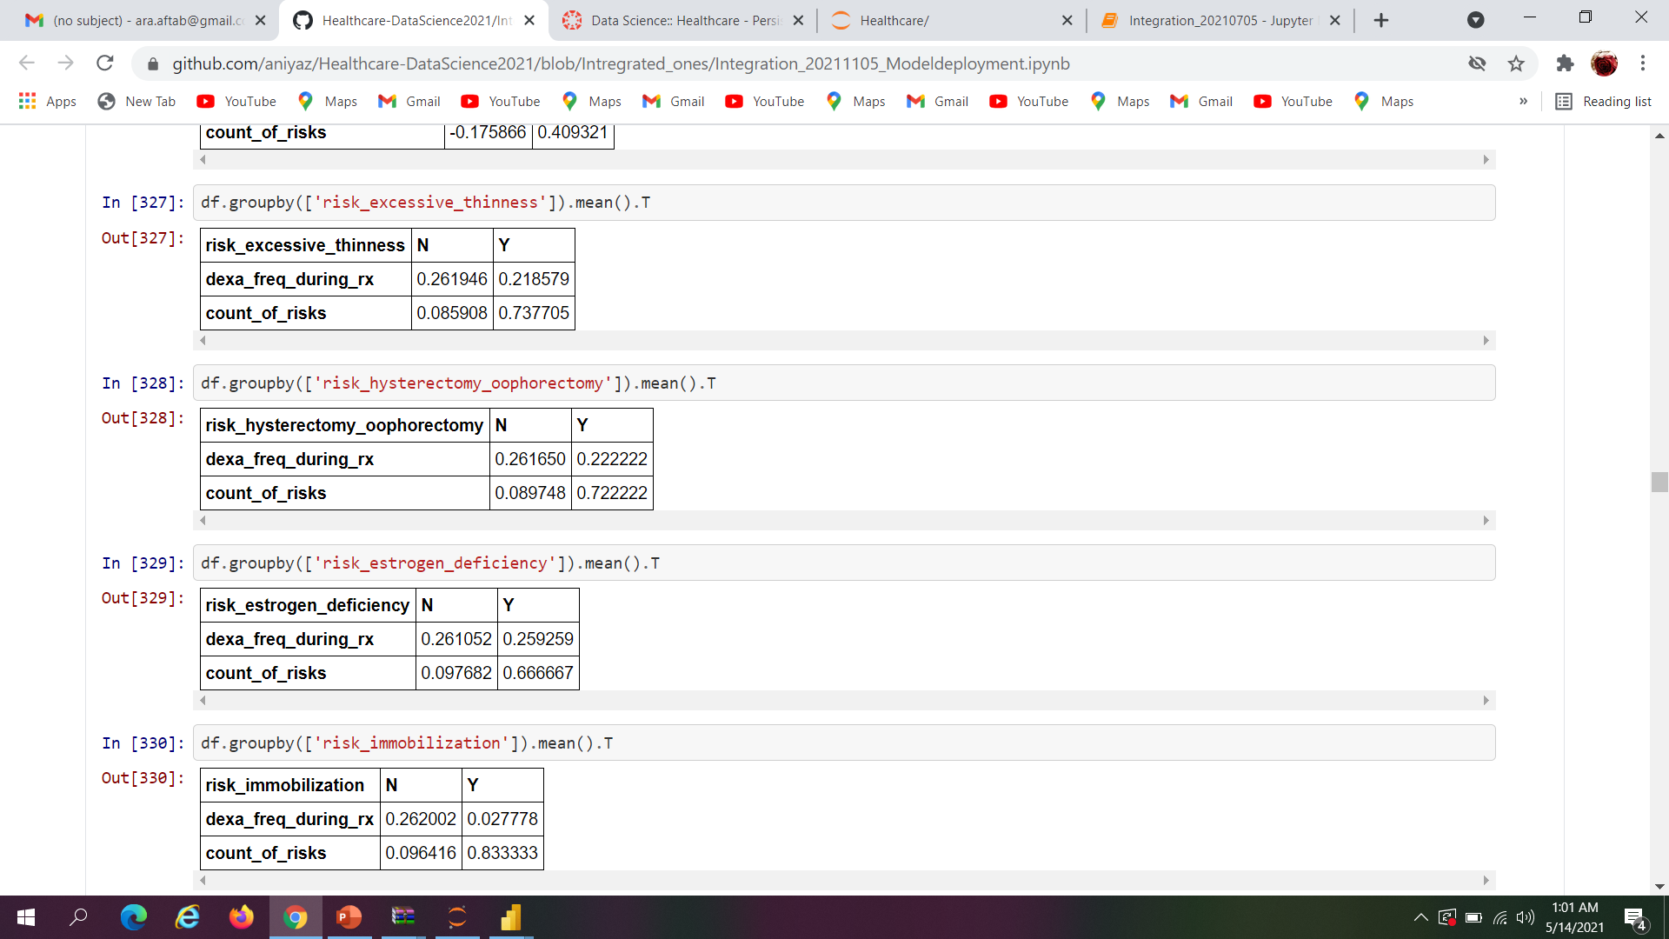
Analysis of Means group-wise
Mean group wise analysis of risk due to excessive thinness, risk due to hysterectomy oophorectomy and risk due to immobilization during administration of dexa and risk count

Slide 24
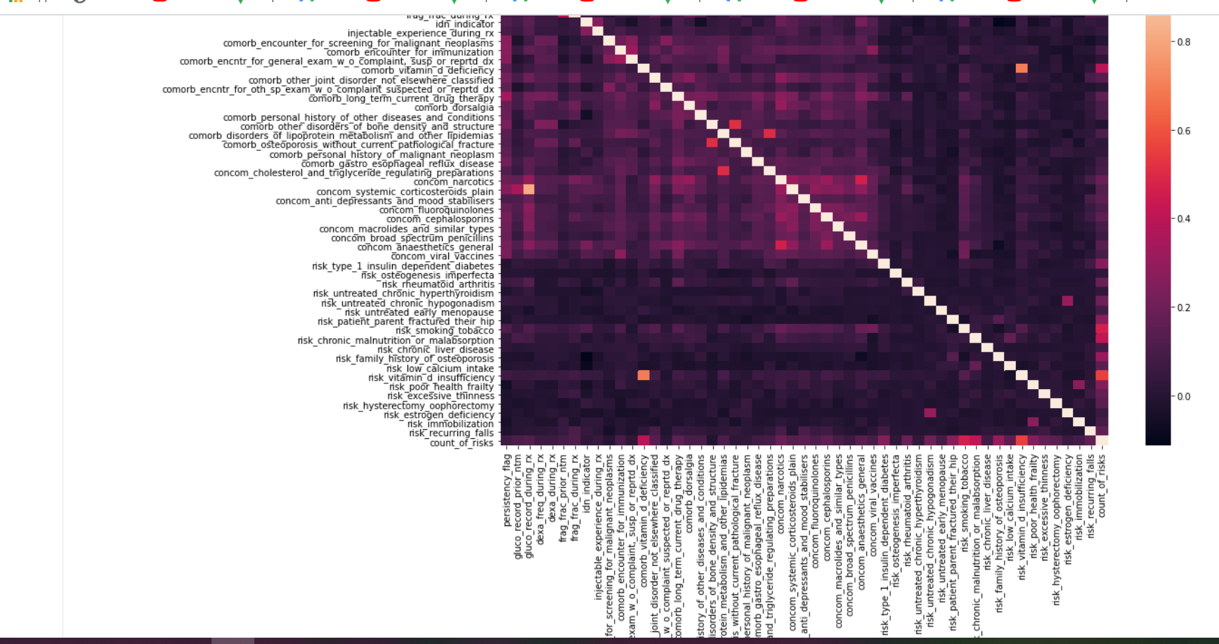
Analyzing dependency of variable (After Transformation)

Slide 25
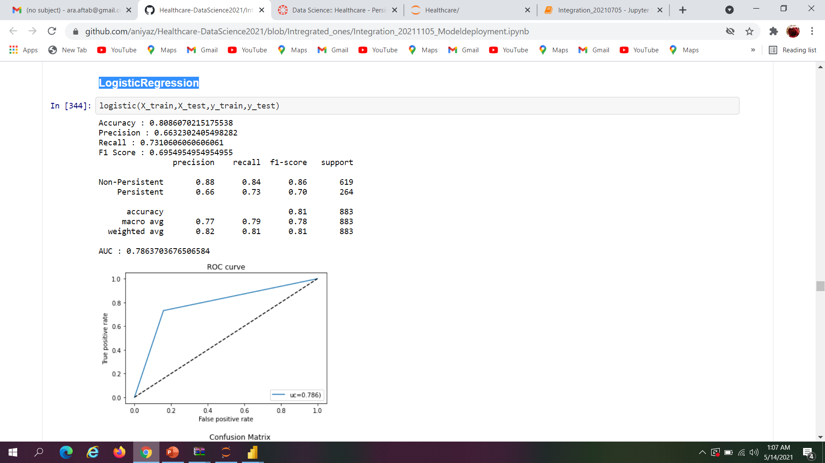
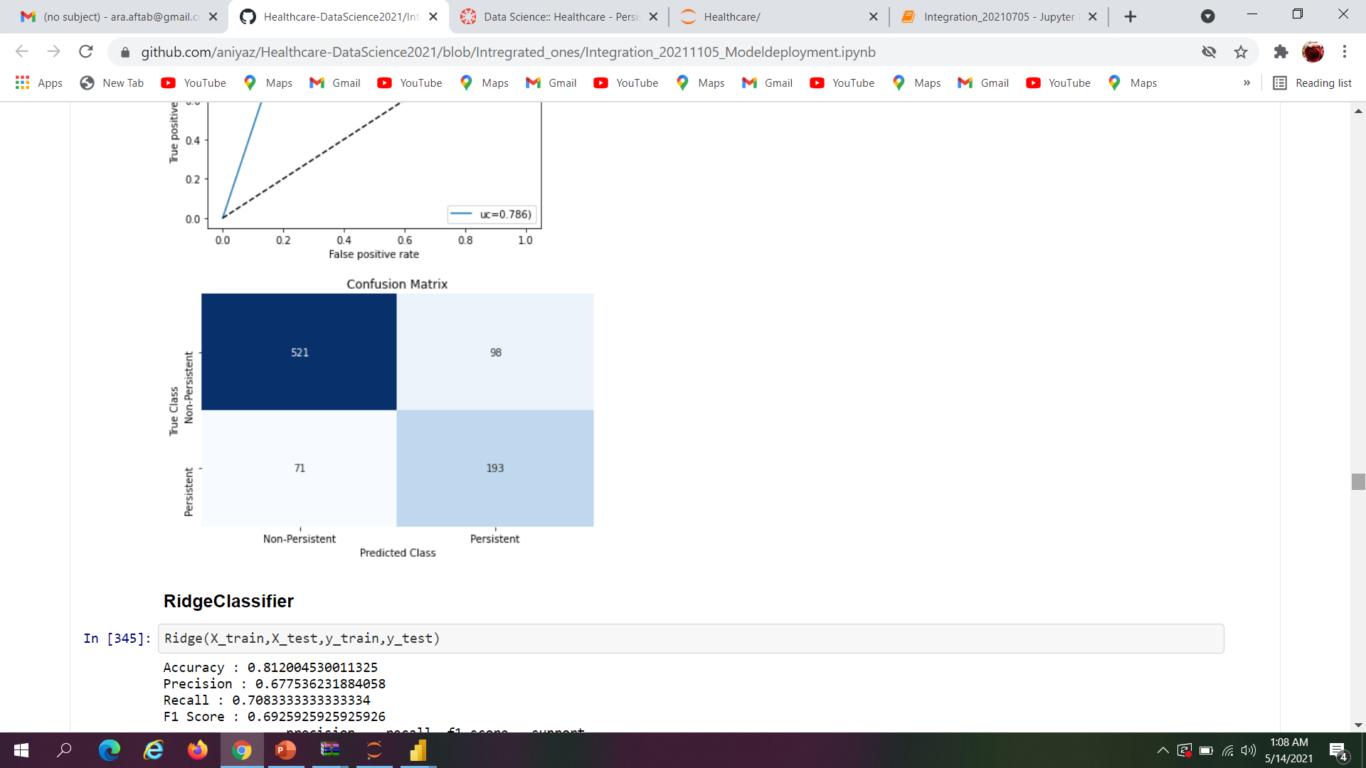
Model Creation-Logistic Regression
Logistic Regression Model shows the Accuracy, Recall, Precision ,f1 score and Support of Non-Persistent and Persistence of drugs.

Slide 26
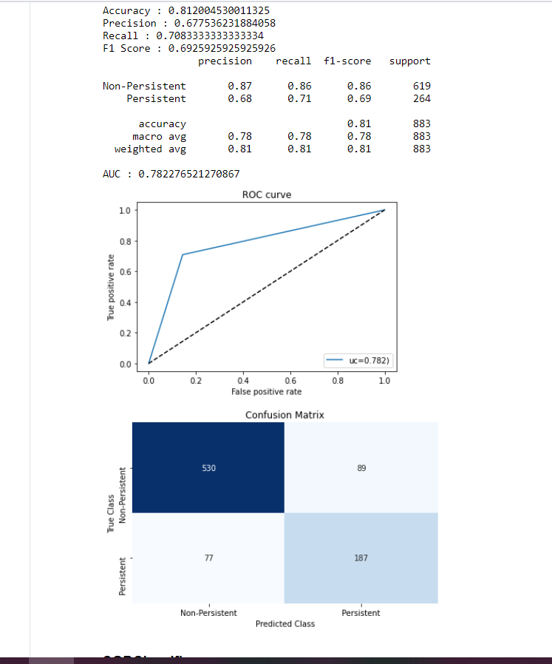
Model Creation- RidgeClassifier
Ridge Classifier Model shows the Accuracy, Recall, Precision ,f1 score and Support of Non-Persistent and Persistence of drugs.

Slide 27
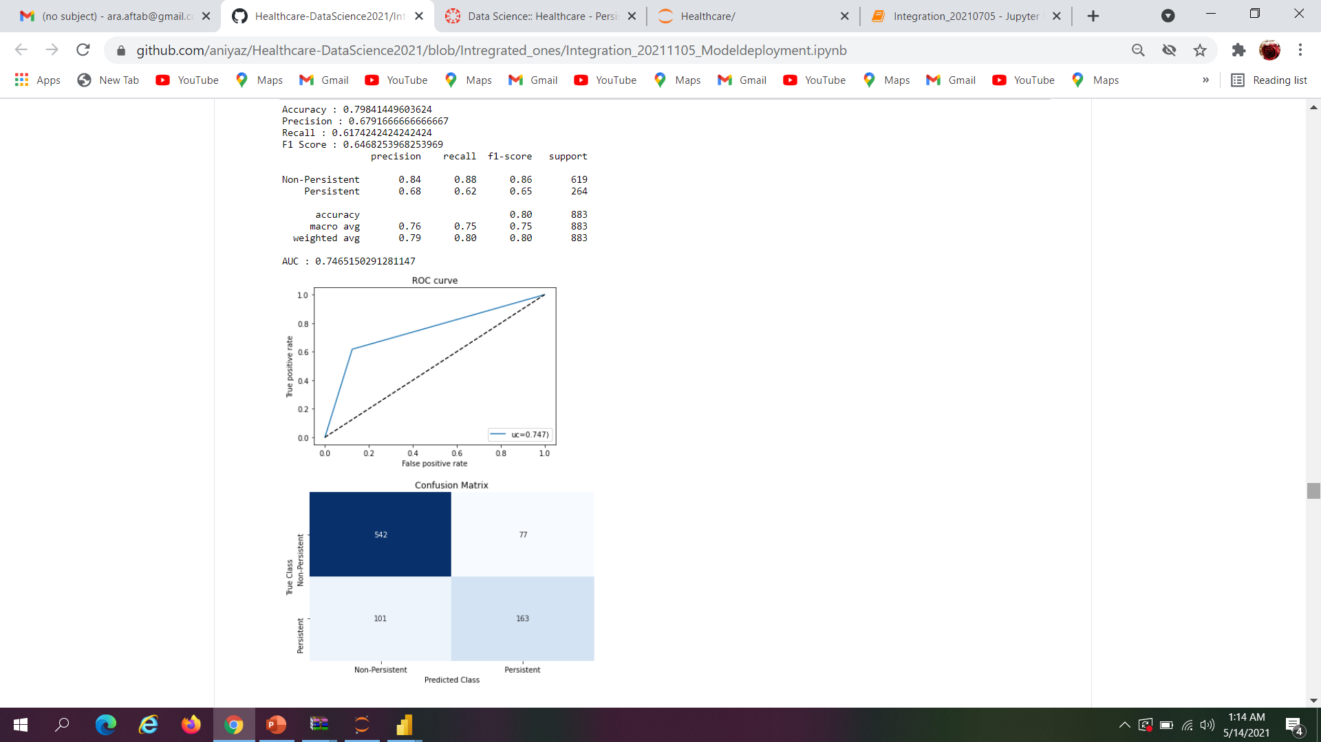
Model Creation-SDG Classifier
SDG Classifier Model shows the Accuracy, Recall, Precision ,f1 score and Support of Non-Persistent and Persistence of drugs.

Slide 28
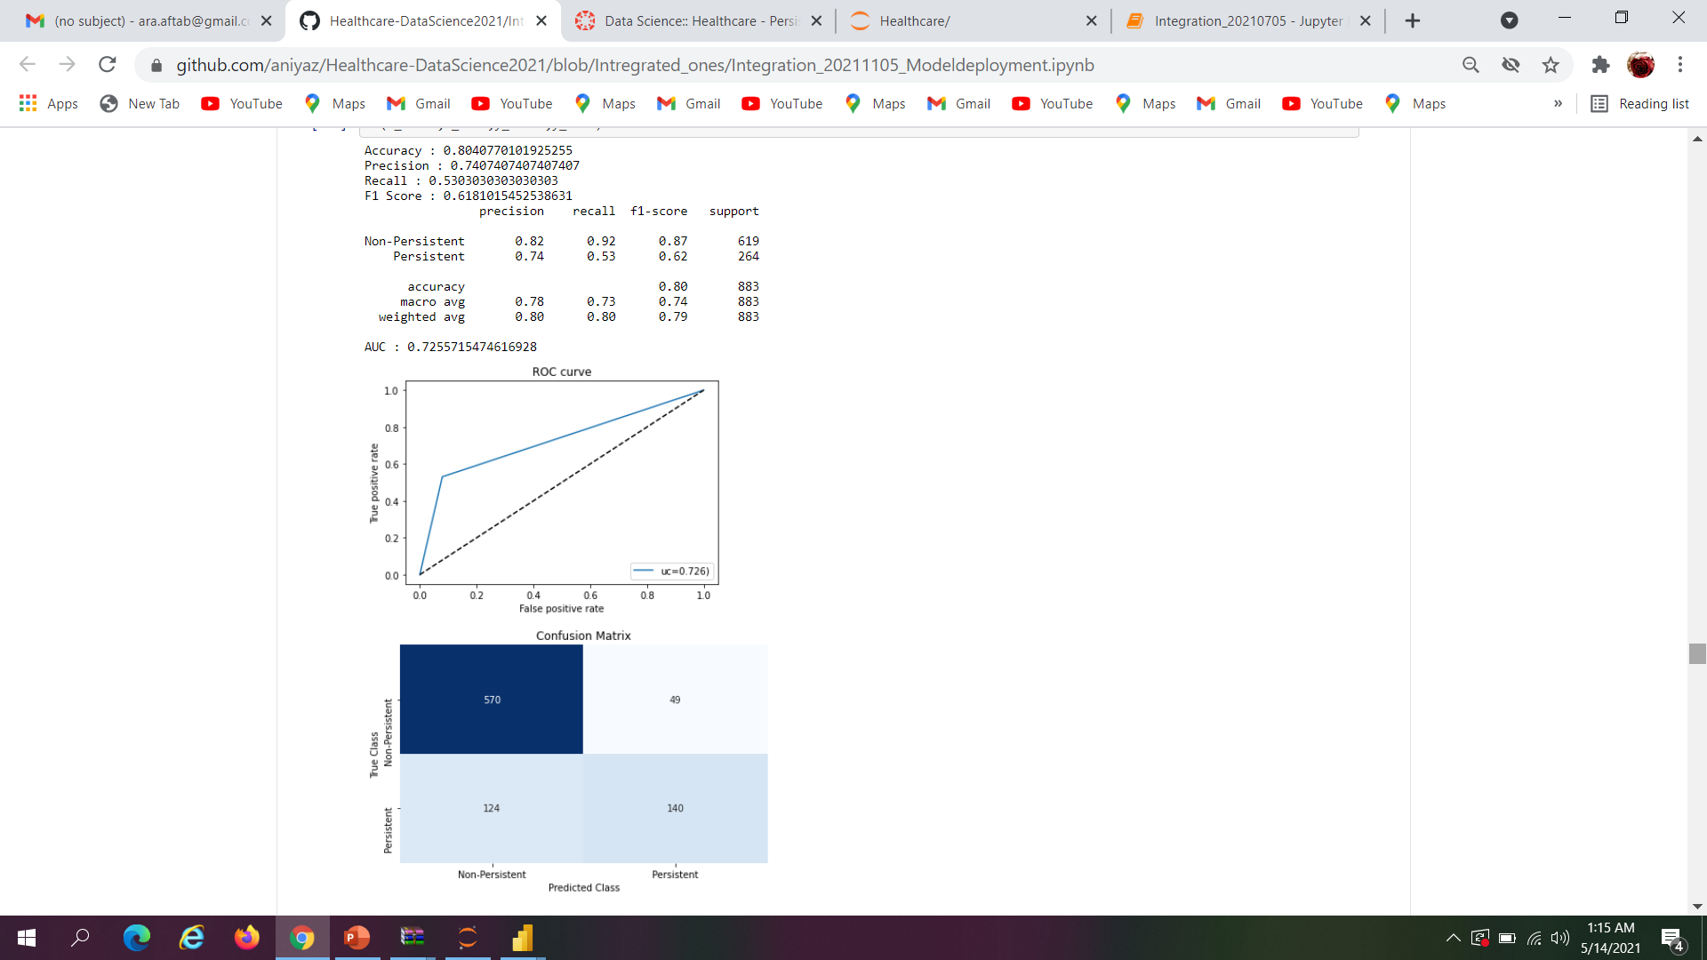
Ensemble and Boosting Models Random Forest Classifier
Random Forest Classifier Model shows the Accuracy, Recall, Precision ,f1 score and Support of Non-Persistent and Persistence of drugs.

Slide 29
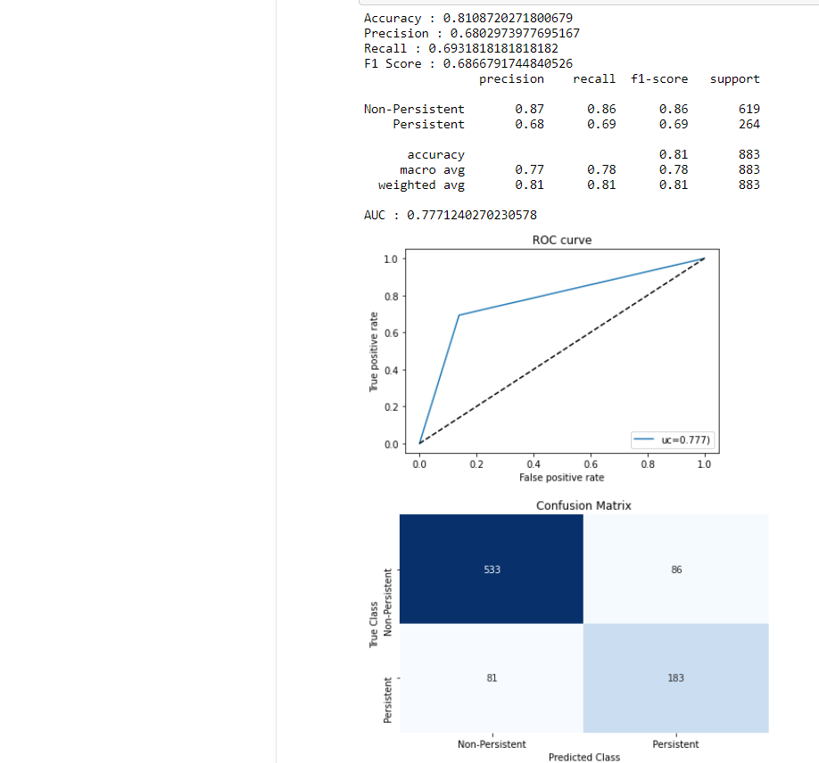
Bagging Classifier
Bagging Classifier Model shows the Accuracy, Recall, Precision ,f1 score and Support of Non-Persistent and Persistence of drugs.

Slide 30
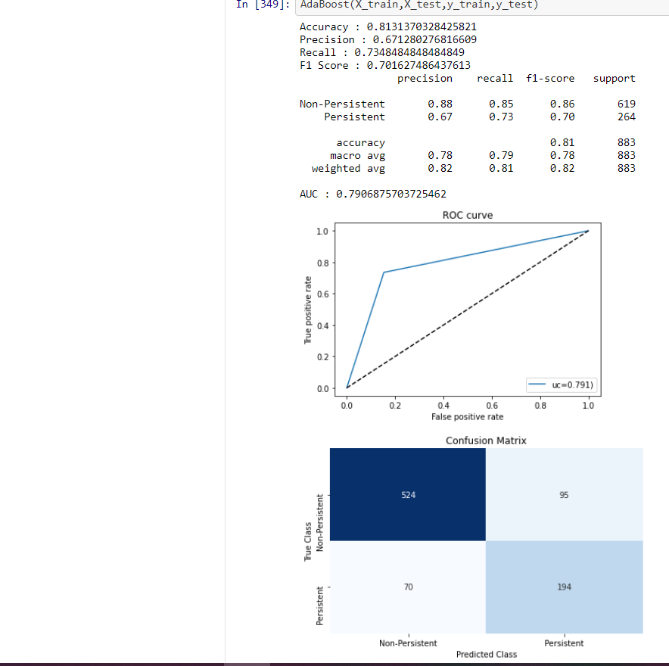
Ada Boost Classifier
Ada boost classifier shows the Accuracy, Recall, Precision ,f1 score and Support of Non-Persistent and Persistence of drugs.

Slide 31
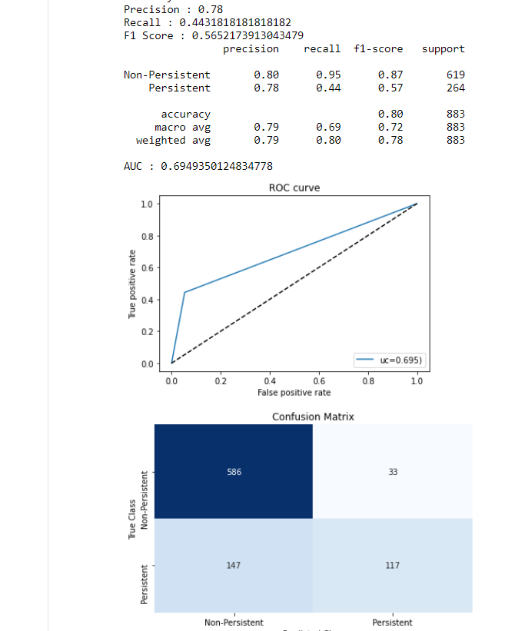
Extra Trees Classifier
Extra Trees classifier Model shows the Accuracy, Recall, Precision ,f1 score and Support of Non-Persistent and Persistence of drugs.

Slide 32
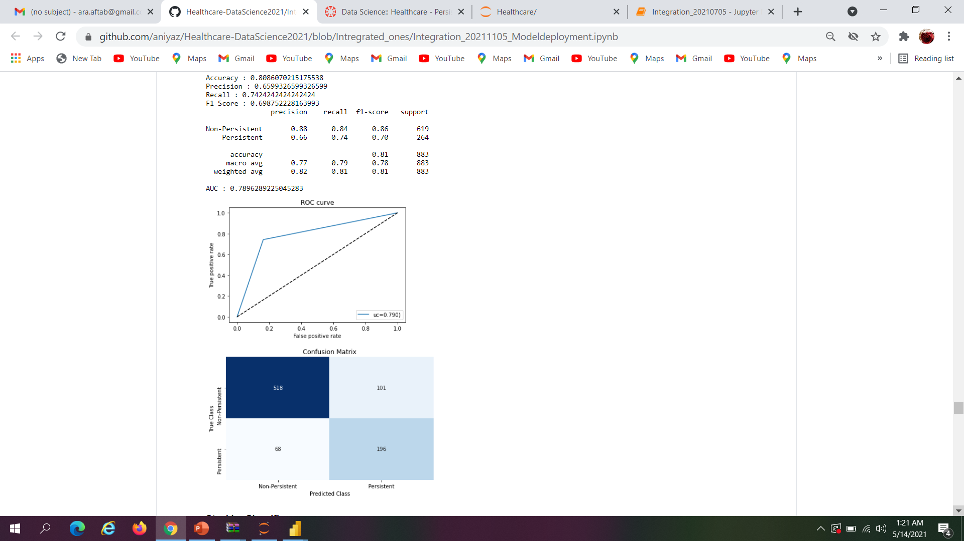
Gradient Boosting Classifier
Gradient Boosting Classifier shows the Accuracy, Recall, Precision ,f1 score and Support of Non-Persistent and Persistence of drugs.

Slide 33
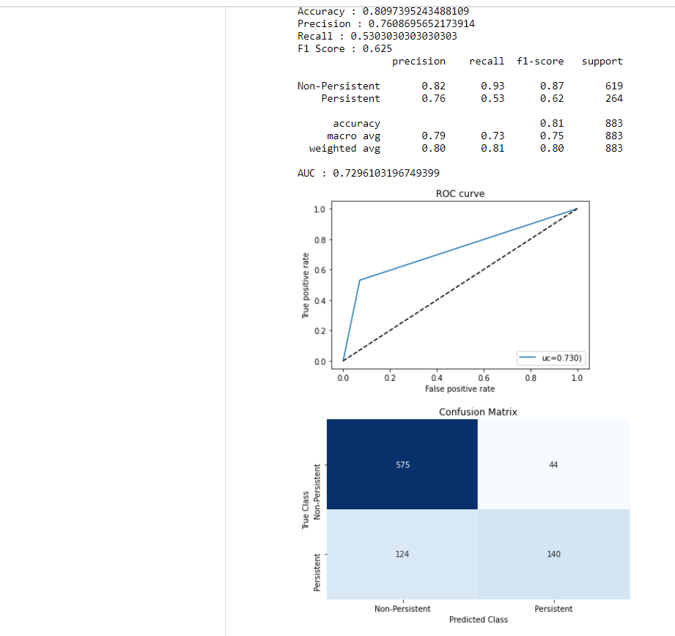
Stacking Classifier
Stacking Classifier Model shows the Accuracy, Recall, Precision ,f1 score and Support of Non-Persistent and Persistence of drugs.

Slide 34
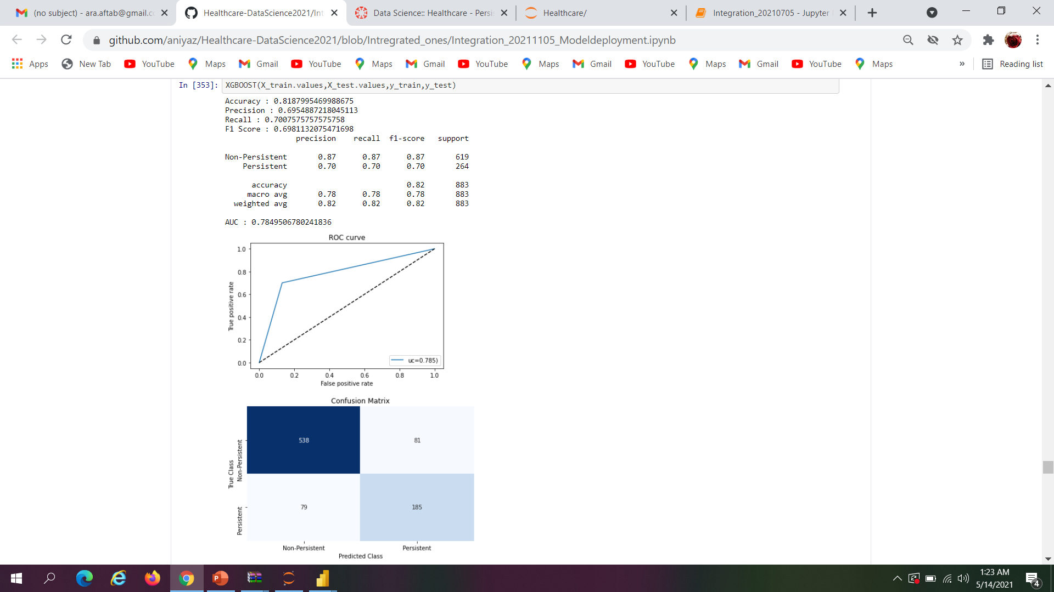
XG Boost Classifier
XG Boost Classifier Model shows the Accuracy, Recall, Precision ,f1 score and Support of Non-Persistent and Persistence of drugs.

Slide 35
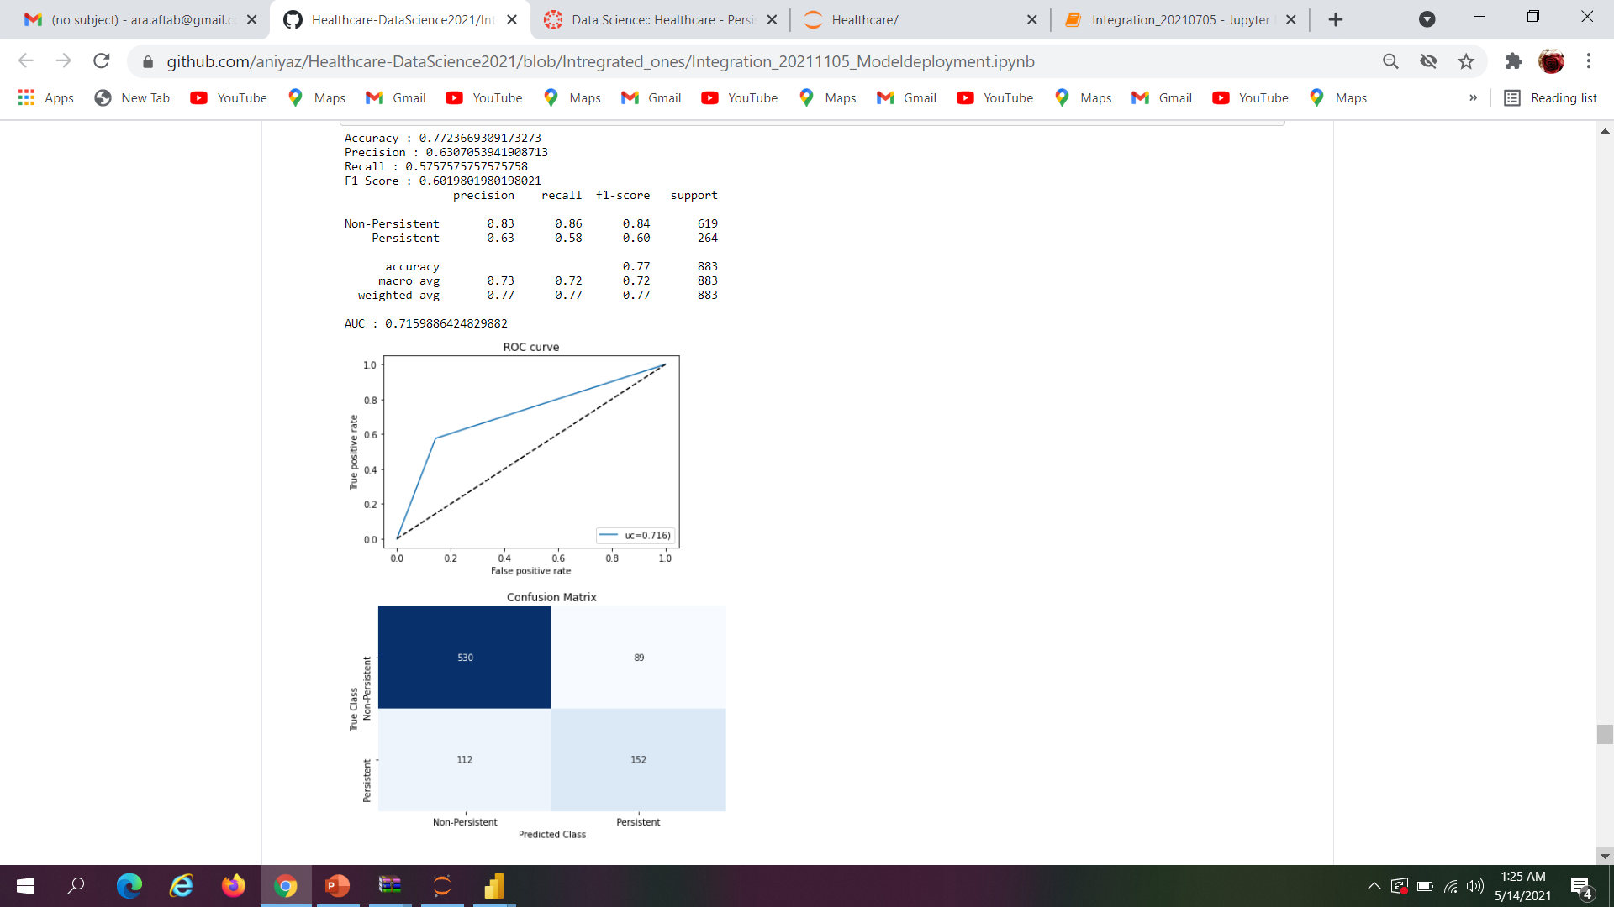
Neural Network Multi Layer Perceptron
Neural network Multi Layer Perceptron shows the Accuracy, Recall, Precision ,f1 score and Support of Non-Persistent and Persistence of drugs.

Slide 36
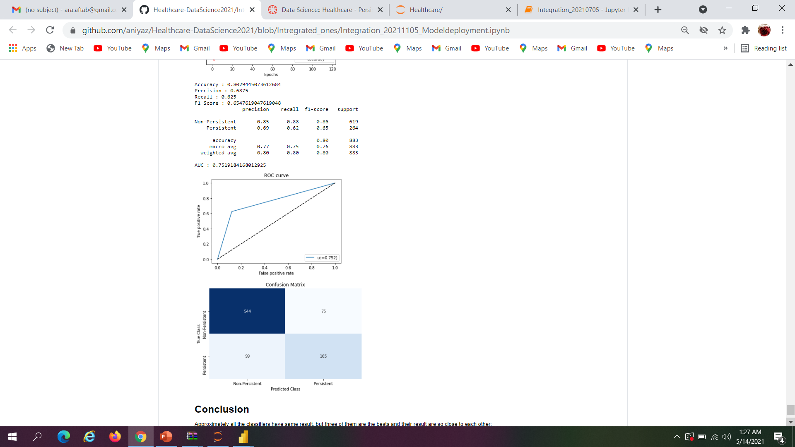
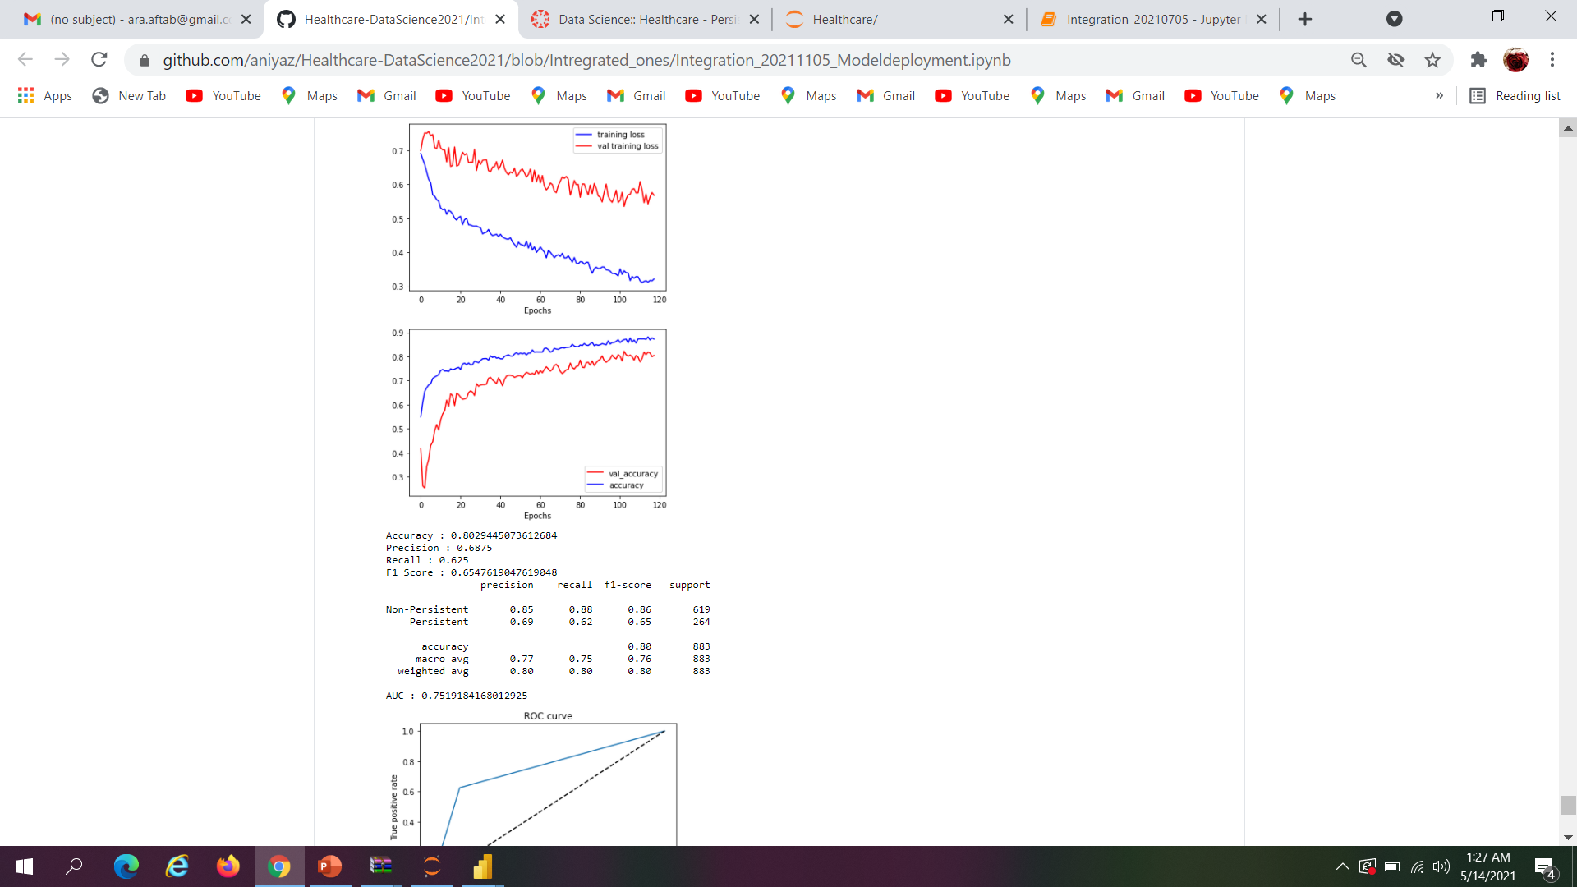
Multilayer Neural Network with Tensorflow/Keras
Multilayer Neural Network with Tensorflow/Keras shows the Accuracy, Recall, Precision ,f1 score and Support of Non-Persistent and Persistence of drugs.

Slide 37
Conclusion
Approximately all the classifiers have same result, but three of them are the bests :
RidgeClassifier (Linear)
AdaBoostClassifier (Ensemble/Boosting)
XGBoostClassifier (Ensemble/Boosting)
They have around 81% Accuracy, 68% Precision, 71% Recall, 70% F1 Score, 78% AUC. We can also see the results for each classifier as well.

Slide 38
Thank You

